Slide 1

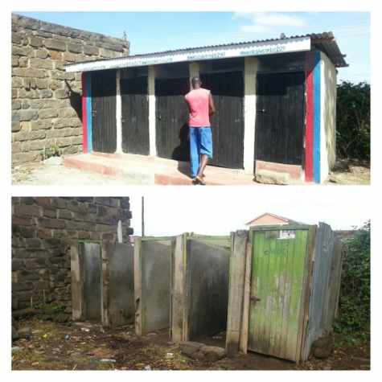
UBSUP
DO’s and DON’Ts of toilet construction

Slide 2
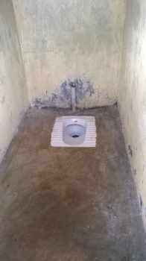
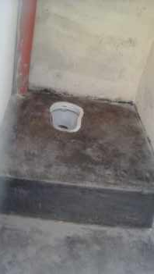
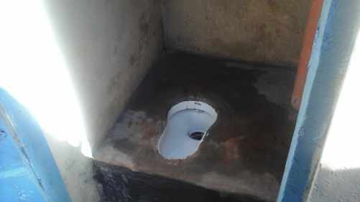
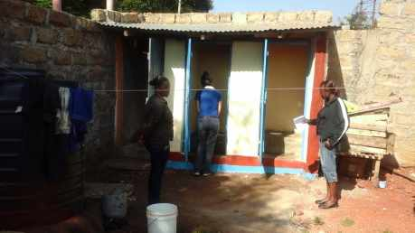
DON’Ts
Squatting pan not in a central position: too close to the back or side walls

Slide 3
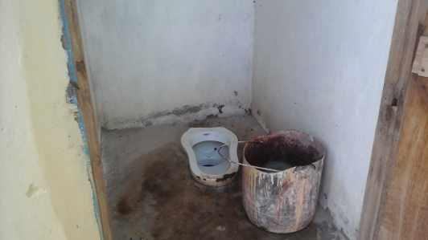
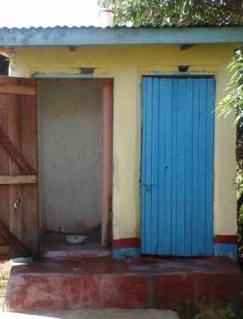
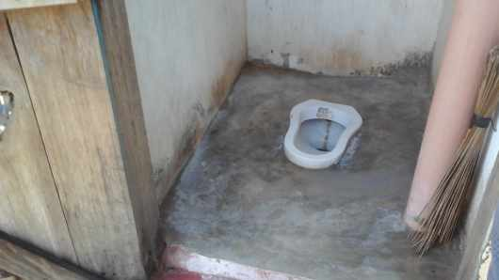
DON’Ts
Edge of the squatting pan not aligned with the floor level. Difficult cleaning.

Slide 4
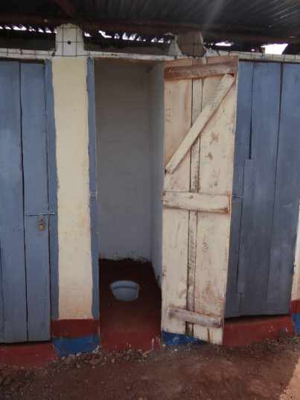
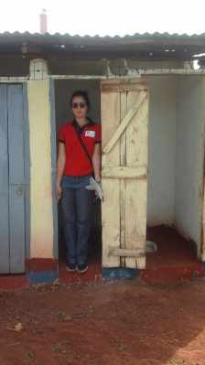
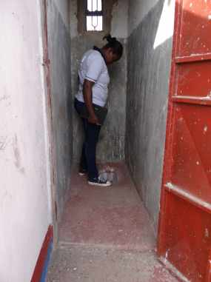
DON’Ts
Dimension not respected. Width too narrow. Height too short.

Slide 5
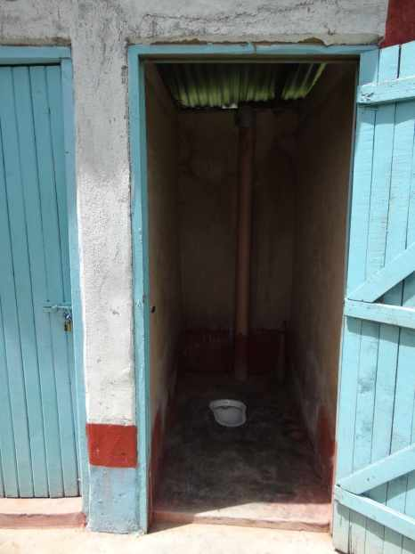
DON’Ts
No windows / opening to let the light in and allow proper aeration

Slide 6
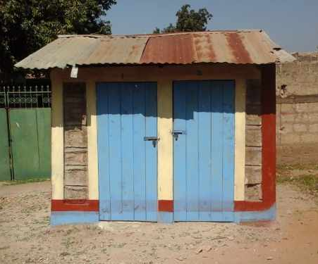
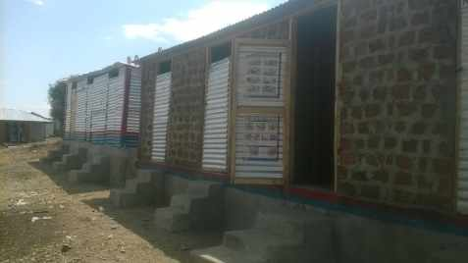
DON’Ts
No paint nor keying of the outside masonry walls. Old mabati sheets used for roofing (or even walls). Aesthetic should be taken care of.

Slide 7
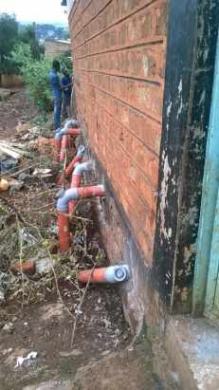
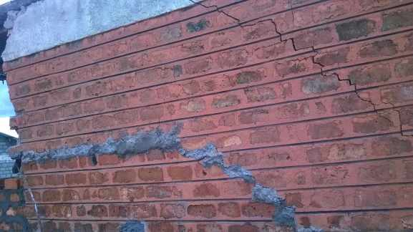
DON’Ts
Cracks on the masonry walls are caused by either poor quality bricks, no hoop iron each two courses, poor foundation (not compacted enough, loose soil, etc.), wall not straight.

Slide 8
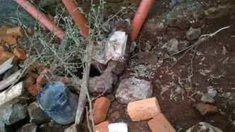
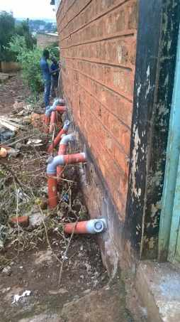
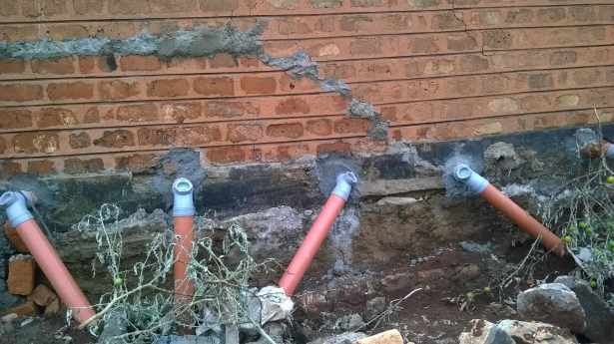
DON’Ts
To save bends and T-pipes, piping is being done poorly

Slide 9
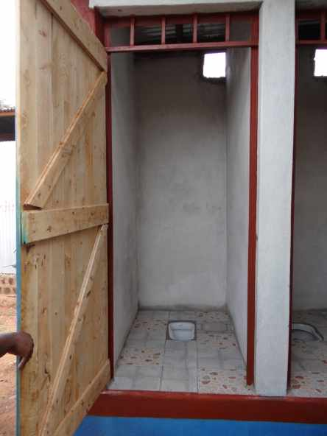
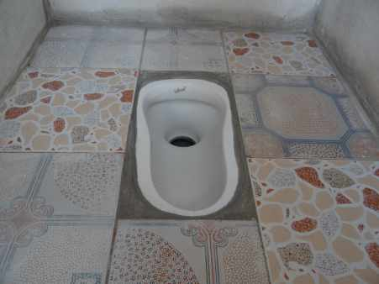
DO’s
Proper dimension. Central position of the squatting pan (aligned with the floor level). Proper aeration and external lighting. Neat finishing and good quality work.

Slide 10
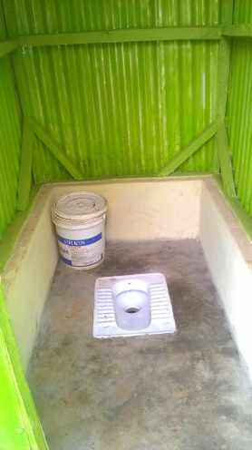
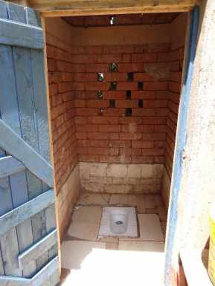
DO’s
Squatting pan at the centre of the cabin. Floor made of smooth concrete (quality formwork), or coated with proper plaster or with tiles. Peripheral edge skirting the slab.

Slide 11
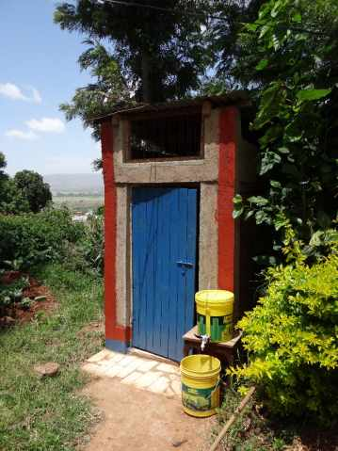
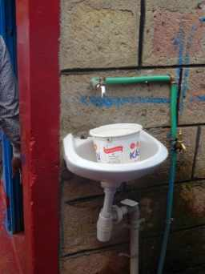
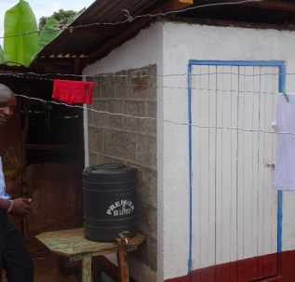
DO’s
Permanent hand washing facility is located next to the toilets

Slide 12
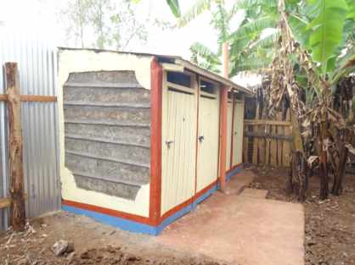
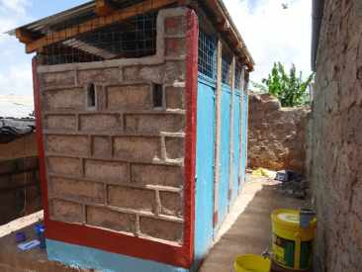
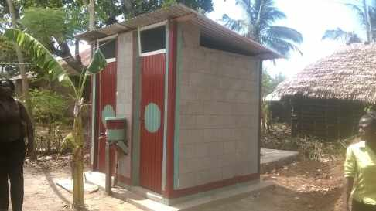
DO’s
Painted doors. WSTF colours: blue and maroon (additional colour allowed). Keying of the outside walls.

Slide 13
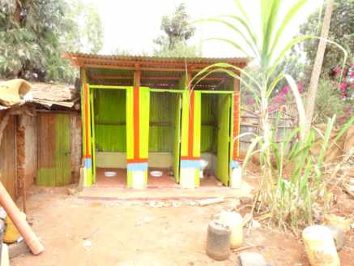
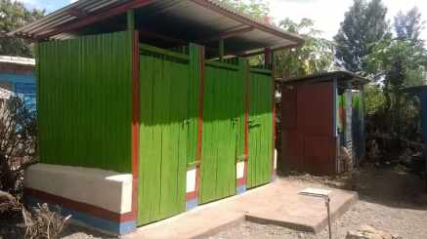
DO’s
Mabati sheets for the walls are allowed on the condition that they are new, painted, reinforced with timber. A peripheral edge of 50cm must be added on top of the slab.

Slide 14
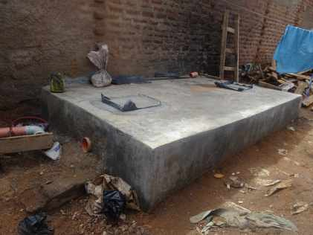
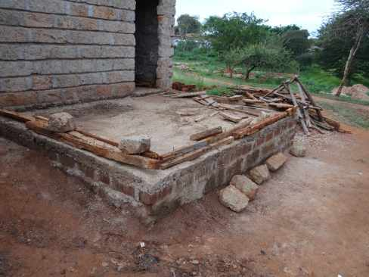
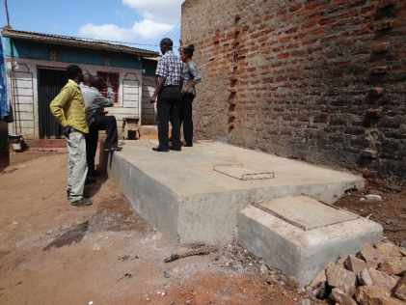
DO’s
Construction of a proper septic tank. Design and dimension according to the technical drawings

Slide 15
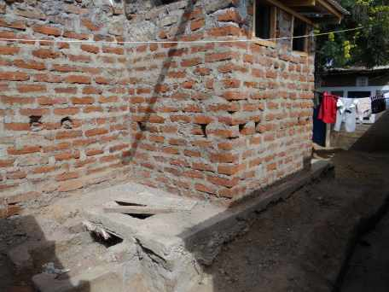
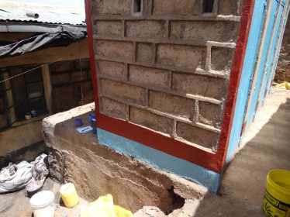
DO’s
If space is scarce, the septic tank can be constructed below the toilets, on the condition that design and measurement are respected and that proper enforcement is ensured on the elevated slab

Slide 16
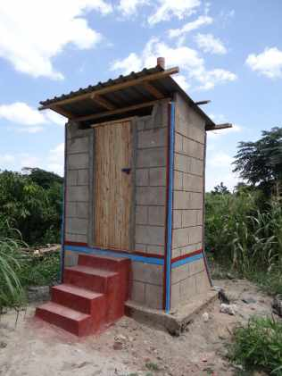
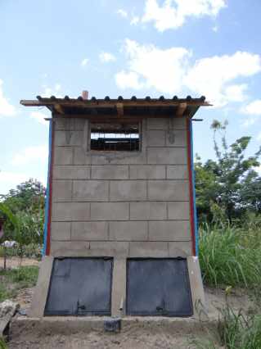
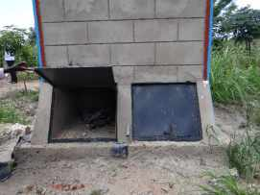
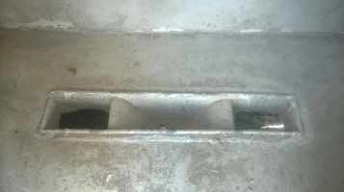
DO’s
Construction of UDDT must be monitored very closely due to the technicity and the non-common nature of the technology. Design and dimension must be respected.

Slide 17
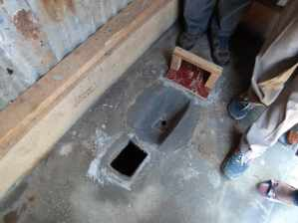
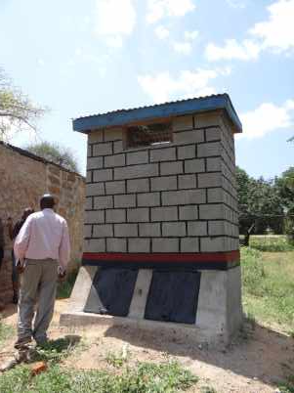
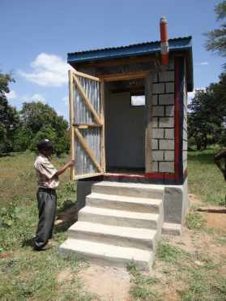
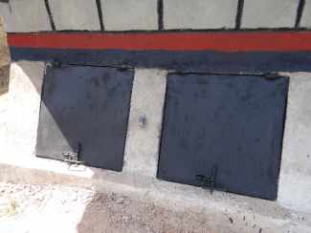
DO’s
Squatting pan can be moulded or fabricated in the slab directly. Ensure that the piping is not apparent in the vaults and that the inside of the vaults are plastered (to facilitate emptying)

